Slide 1
Confessions
of a cross-platform engineer

Slide 2



Andreia Gaita
sh4na (not a typo)
shana
Currently at GitHub
Formerly at Novell, Xamarin, Unity...

Slide 3
What is a cross-platform engineer?

Slide 4


Slide 5
Code tailored
to the platform

Slide 6
Platform:
OS + Environment

Slide 7
Web Apps?
Native UI Apps
Native Tools (no UI)
Libraries
Runtimes
Notes:
Web Apps are by definition the most cross-platform, but at the same time the most removed from the specifics of the platform.

Slide 8
the problem of
Native xplat apps

Slide 9
Native UI apps
hit every problem
and then some

Slide 10


Notes:
If you've used more than one OS, you'll know that everyone does it differently.

Slide 11
Shortcuts
Notifications
Design
Platform styles
App switching
Widgets
Menus

Slide 12
Detour!

Slide 13
Editors
Where are my options?
Living the xplat life
Shortcuts
Shells

Slide 14
Detour done! (for now)
Notes:
Going back to native UI apps! Platform integration

Slide 15
Installers
Services
Launchers
Platform Integration
Filesystem quirks
Installation paths
Notes:
Besides UI-specific issues, native UI apps also need to integrate with the platform.
Case sensitivity.
Platform installers.
Running services.
Where do you put things?
Library/ApplicationSupport vs ~home/.local vs ProgramData vs ???

Slide 16
Split codebase
Native UI toolkits?

Slide 17
One codebase
Xplat UI toolkits?

Slide 18
One codebase
Roll your own UI?

Slide 19
Mobile
One codebase
to bind them all?
(hint: perhaps not)
Desktop
Notes:
Sharing some code is useful
Mobile has resource constraints, UI constraints
Mobile apps should be designed mobile-first
Sharing skills is more important

Slide 20
Xamarin.Forms
Kyvi
Decisions, decisions
Electron
wxWidgets

Slide 21
The Electron solution:
Render on the browser
Code natively (well, about that...)

Slide 22
Libraries, tools and runtimes
Native non-UI

Slide 23
Structure of an xplat framework
High-level API
Platform abstraction
Generated API?
Platform-specific code
I/O
Services
Designed to be consumed by others
Not necessarily the same language
...
Hide platform quirks
Consumed by high-level API

Slide 24











Suppose you want
to target...

Slide 25
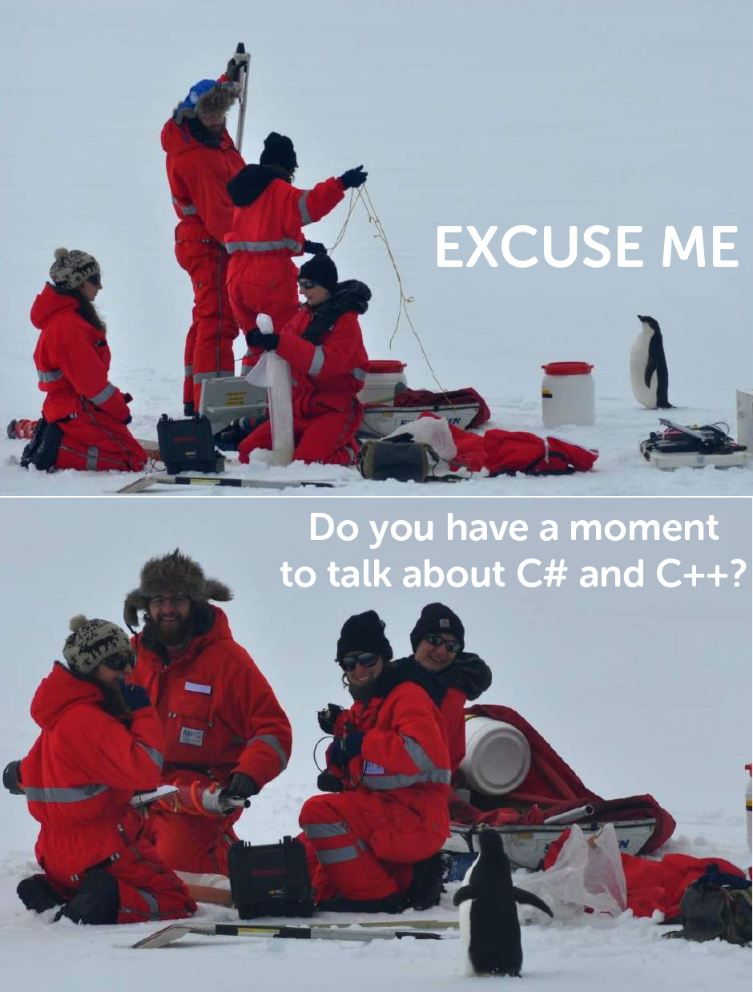

Slide 26
C# and Mono
Runs on
10 20 30 platforms everywhere

Slide 27
C++11 with GCC and Clang
http://goo.gl/WB4I3f

Slide 28
(Why not both?)
Notes:
Unity C#-C++

Slide 29
Your GUI app can be multiple libraries with a UI on top
Notes:
Should be.
Hard split of UI and business logic
Can do it in any language, really

Slide 30
Constraints on your primary platform:
Target platforms
Languages & frameworks
Notes:
Choosing a primary platform from which to cross-compile
Choosing an IDE

Slide 31
Build tools

Slide 32
Story time
Notes:
Moonlight builds. Small game engine

Slide 33
Choose targets
Choose language / framework
Choose source
Choose build tools

Slide 34
Build tool?
Cross-platform
Multiple targets, decent granularity
Customizable and extendable
Parallelizable
Maintained and documented

Slide 35
cmake
autotools
msbuild/xbuild
Examples
jam
gradle
ninja

Slide 36
perl
python
Scripting the tools
native shell scripts

Slide 37
Story time
Notes:
Unity build system – jam, perl, code generator

Slide 38
Visual Studio
XCode
Generate project files
Insert popular target platform IDE here

Slide 39
Be
adaptable

Slide 40
It's going to be
uncomfortable
deal with it

Slide 41
There's more! but I ain't got time
Tests
CI
Dependencies
Packaging

Slide 42
Thank you!
Questions anyone?
sh4na
Andreia Gaita
shana

Slide 43



Slide 44
Develop for the hardware
Know your hardware

Slide 45
VR Devices

Slide 46
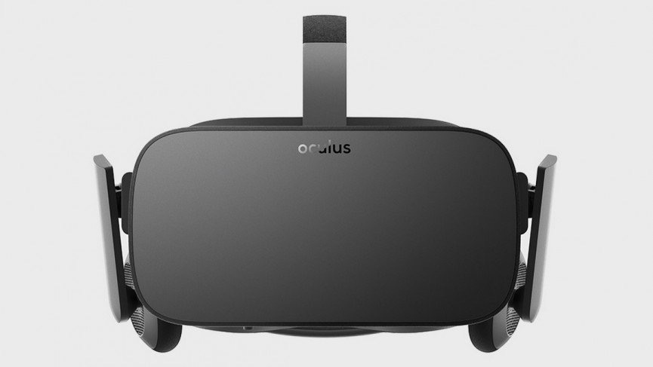
Oculus
Rift
Notes:
The oculus was the device that started the craze. There’s been 4 devices so far, the DK1, DK2, Crescent Bay and CV1, the consumer version which is set to be released in 2016

Slide 47
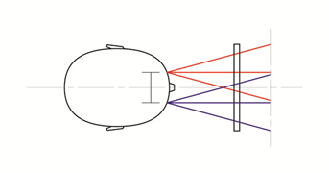
Two cameras, two eyes

Slide 48
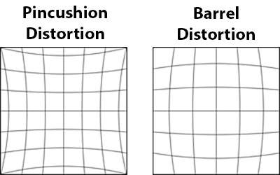

Slide 49
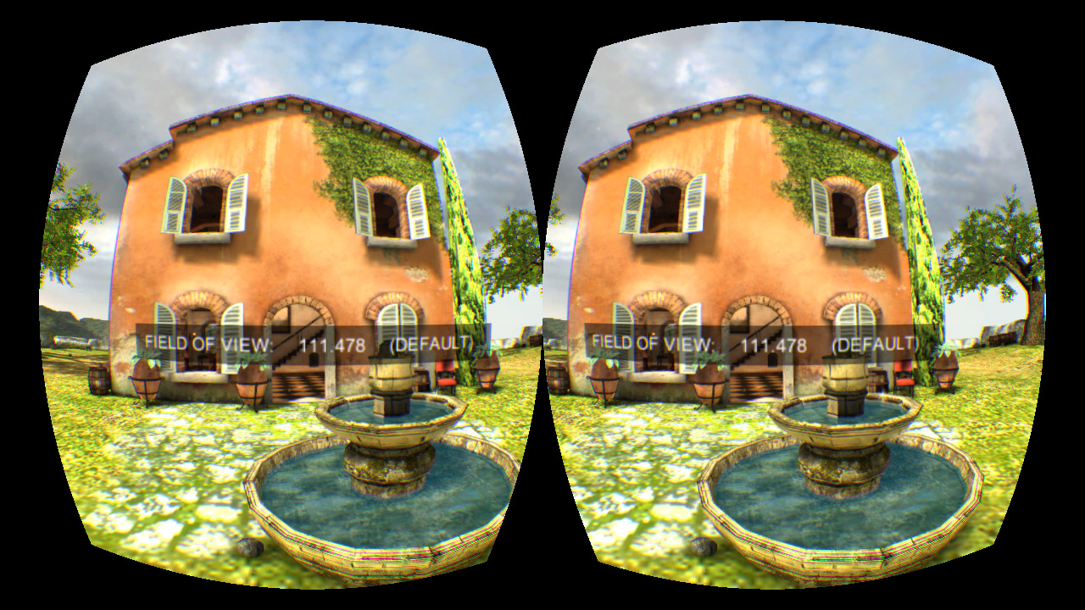

Slide 50
Accelerometer
Magnetometer
Gyroscope

Slide 51
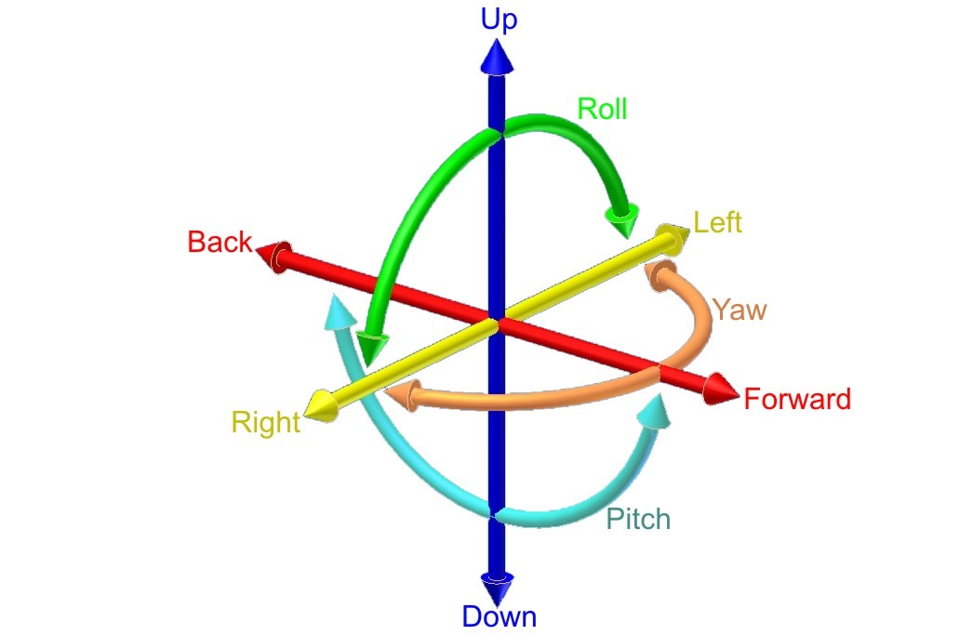

Slide 52
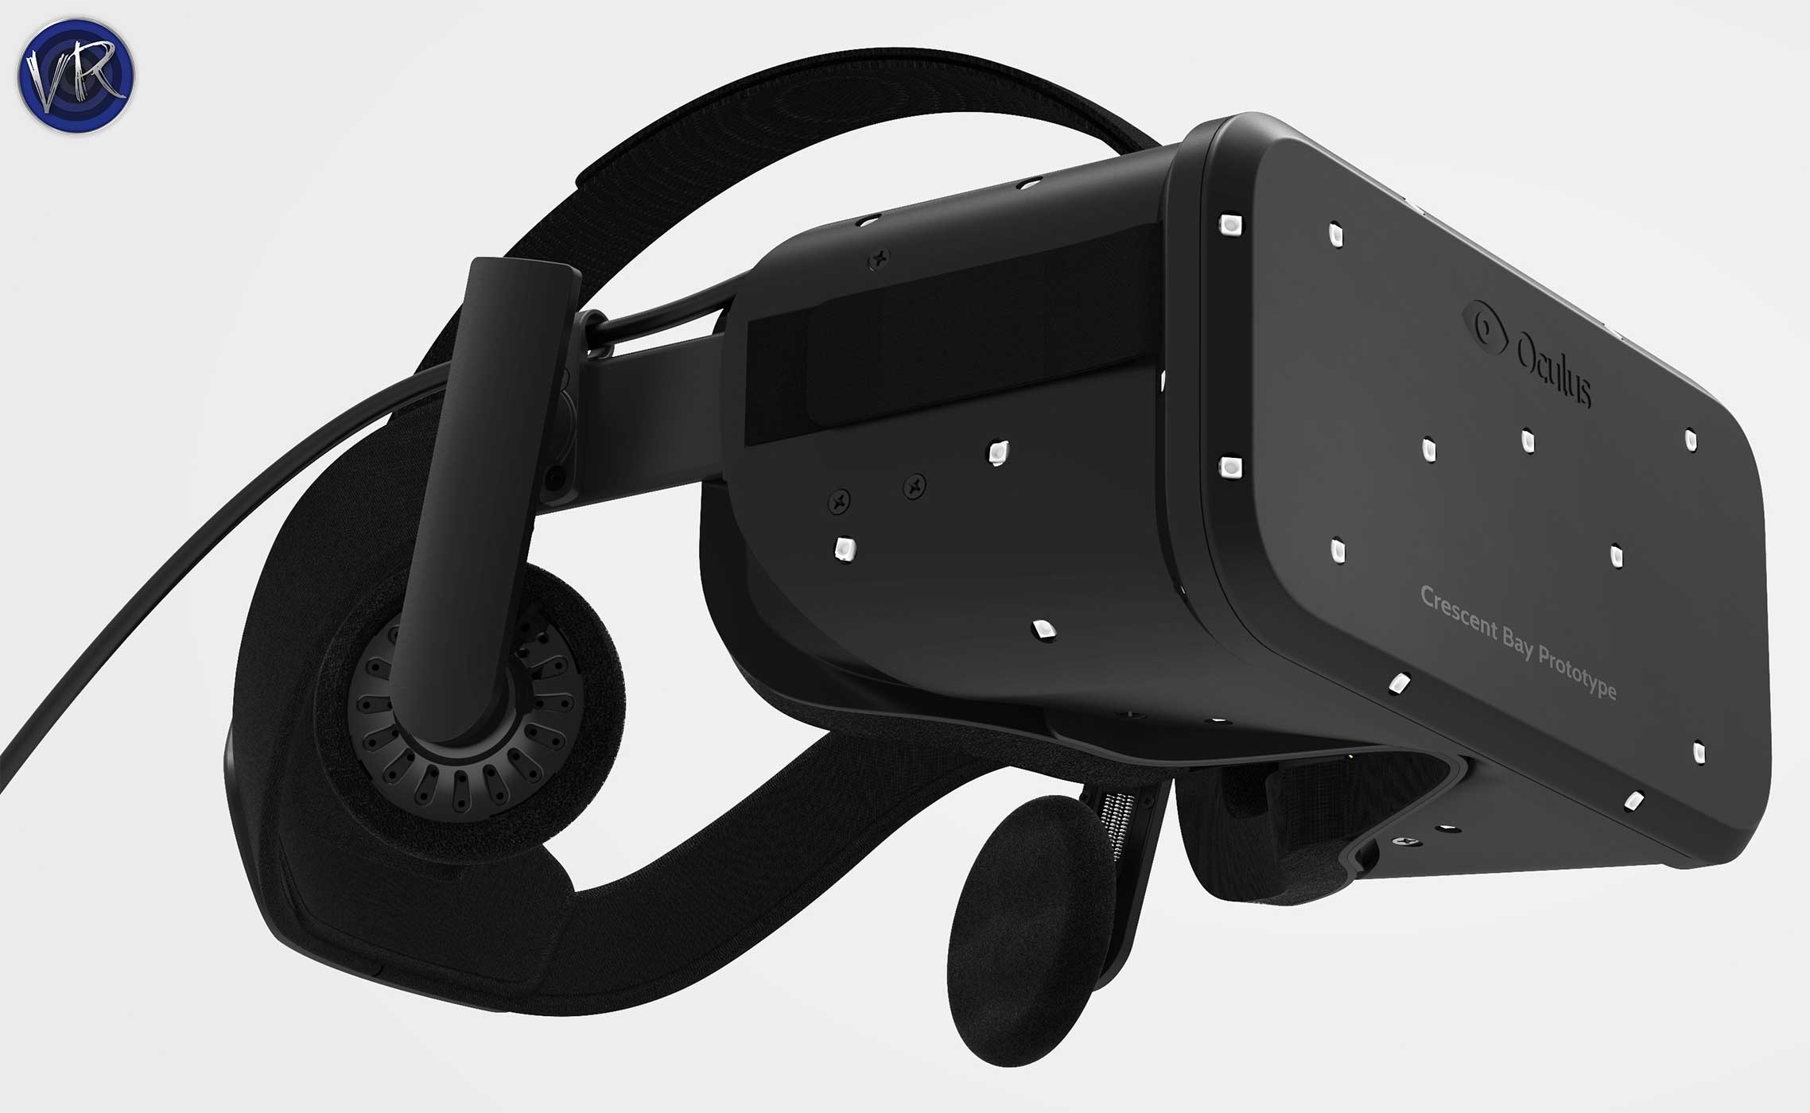

Slide 53
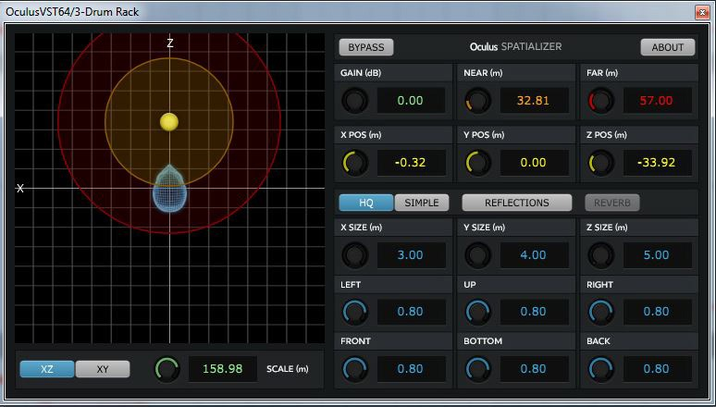
3D positional audio

Slide 54
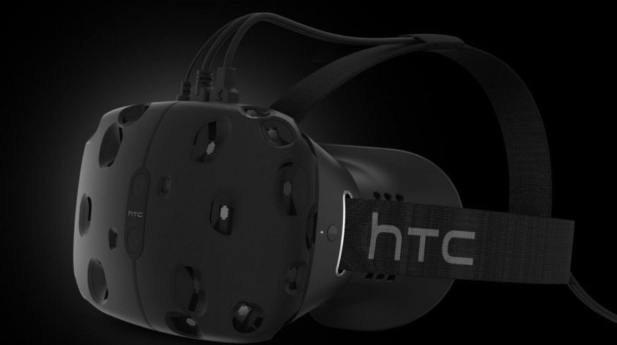
Valve / HTC
Vive

Slide 55
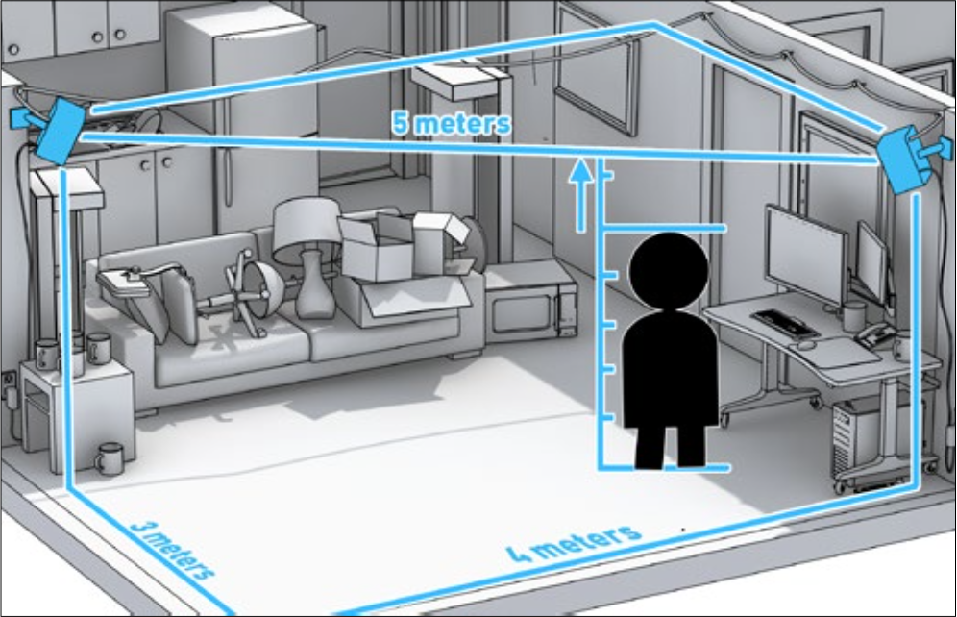

Slide 56
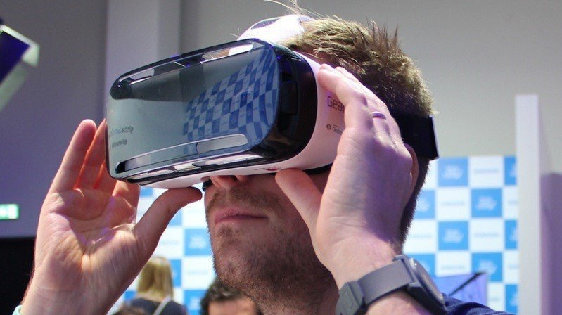
Oculus/Samsung
Gear VR

Slide 57
Tip: Watch your CPU/GPU usage

Slide 58
Tip: Avoid overheating by keeping the device plugged in

Slide 59
Tip: Keep the original cable

Slide 60
Tip: Enable VR developer mode
Notes:
Settings / Applications / Application Manager / Gear VR Service / Manage Storage / Tap VR Service version 6 times

Slide 61
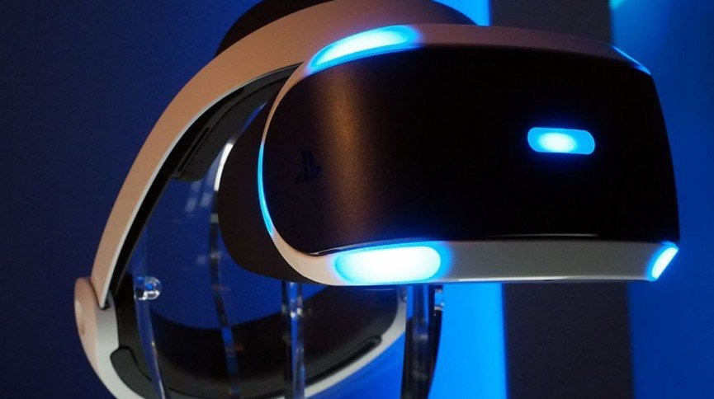
Sony
Playstation VR

Slide 62
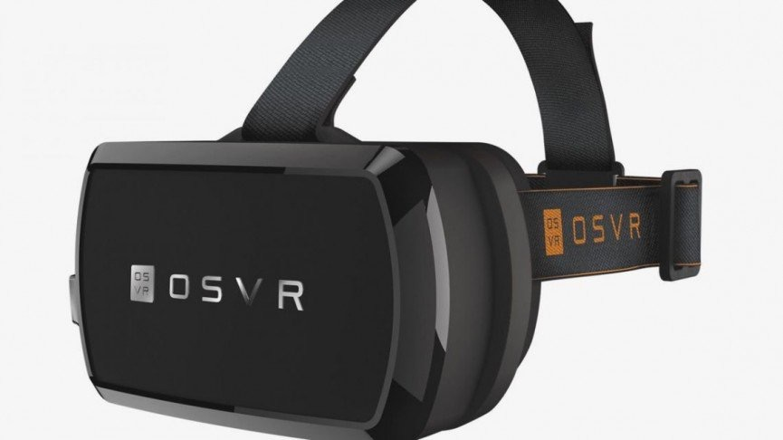
Razer
OSVR

Slide 63
Archos VR
GameFace Mobile VR
Fove VR
Zweiss VR One
Aura Visor
Google Cardboard
Freefly VR
Avegant Glyph
Notes:
And then there’s the Archos and the Google Cardboard, the Aura Visor kickstarter, the Swiss VR One, the FOVE which boasts eye-tracking technology, the Freely, the Avegant, and so many more, oh my

Slide 64
AR Devices

Slide 65
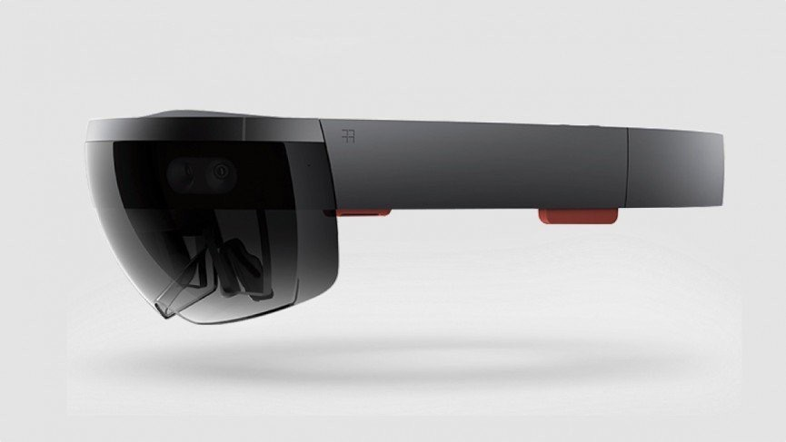
Microsoft
HoloLens

Slide 66

Google
Glass

Slide 67

Magic Leap

Slide 68
Controllers

Slide 69

Oculus
Touch controller

Slide 70
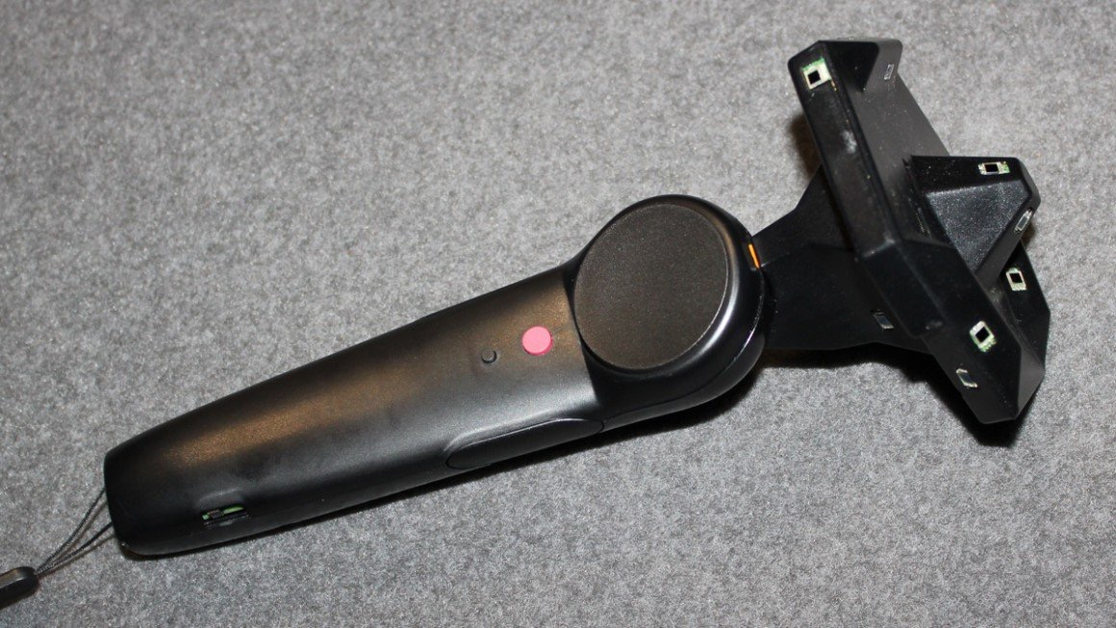
Valve/HTC
Vive controller

Slide 71

Playstation VR
Move controller

Slide 72
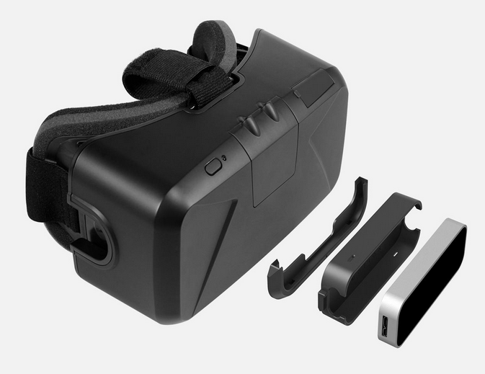
Leap Motion
Notes:
The leap motion controller is a

Slide 73
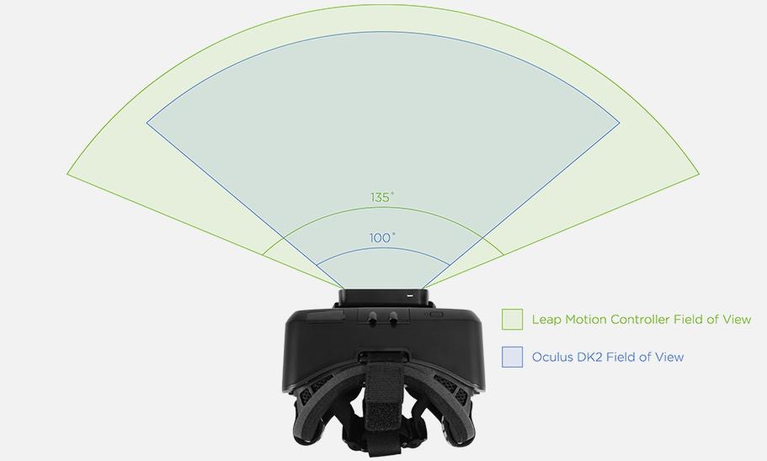
Leap Motion
FOV

Slide 74
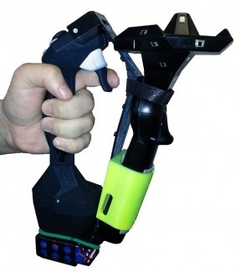
Tactical Haptics
Reactive grip

Slide 75
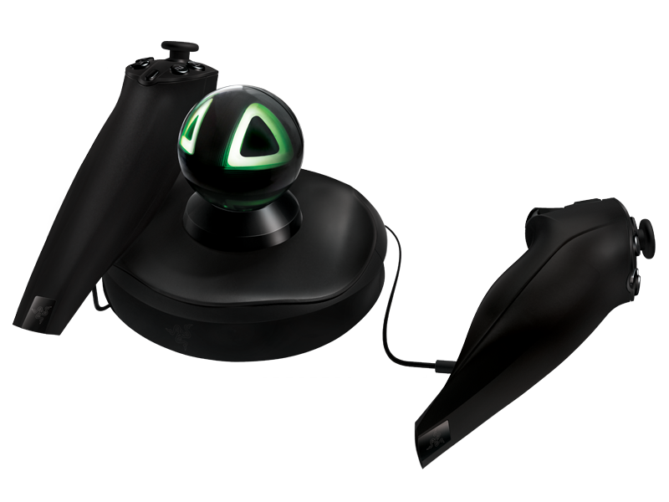
Razer
Hydra

Slide 76
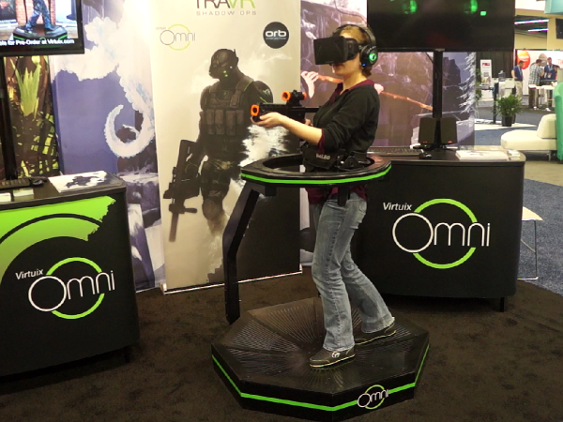
Virtuix
Omni

Slide 77

Looks familiar?

Slide 78
VR and AR

Slide 79
Virtual Augmented
Immersion Interaction

Slide 80
VR immerses you into a different environment

Slide 81
You can’t see where you are in the real world
Tracking your position is key

Slide 82
Headset tracking
gyroscope accelerometer magnetometer
External tracking
usually cameras

Slide 83
AR adds content to your existing environment

Slide 84
You can see and move around your real world environment
Tracking what you look at is key

Slide 85
let’s talk
best practices

Slide 86
VR is bad at
Legible text
Tactile feedback
The real world

Slide 87
Scale

Slide 88
1 unit = 1 meter
Scale of the world
One finger target: 20mm

Slide 89

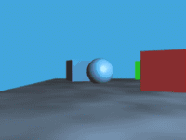

Relative size
Scale in 2D
Parallax
Familiar objects

Slide 90
Eyes rotate inwards as objects get closer
Scale in 3D
IPD + distance to object == size

Slide 91
Tip: Change scale by manipulating IPD & height
http://kholdstare.github.io/technical/2013/10/06/sense-of-scale-vr.html

Slide 92
simulation
sickness

Slide 93
sensory information
sense of position and self
Proprioception

Slide 94
UGH
movement in VR
no movement IRL

Slide 95
Destiny
UI counter motion
Apple
parallax
Not only in VR
Witcher 3
blur and distortion

Slide 96
Framerate
Latency
Motion

Slide 97
Tip: Framerate >= device rate
60HZ minimum

Slide 98
Tip: Latency < 20ms

Slide 99
Tip: No sudden movements!

Slide 100
Tip: No unexpected movements!

Slide 101
Tip: No shakey-cam

Slide 102
Tip: No cinematic panning

Slide 103
Tip: No head bobbing

Slide 104
Tip: Avoid lateral motion

Slide 105
Tip: Keep the speed constant

Slide 106
Tip: No flashing or bright lights

Slide 107
Tip: Use the players profile

Slide 108
Tip: Concentrate the action in the center of view

Slide 109
Tip: Use the elevator

Slide 110
Tip: No motion blur or depth of field effects

Slide 111
UI

Slide 112
Lens distortion
Text rendering
Blurriness

Slide 113
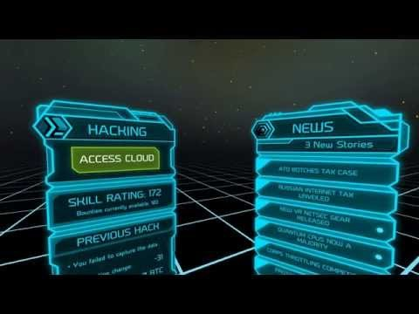
Tip: Keep text short and close to the center of vision

Slide 114
Tip: Put text on concave surfaces

Slide 115
Tip: Menus should follow motion

Slide 116
Tip: Increase text contrast

Slide 117
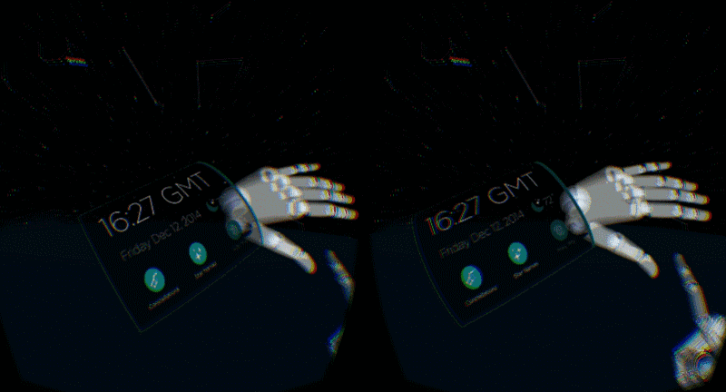
Tip: Responsiveness and Reactiveness

Slide 118
Examples

Slide 119
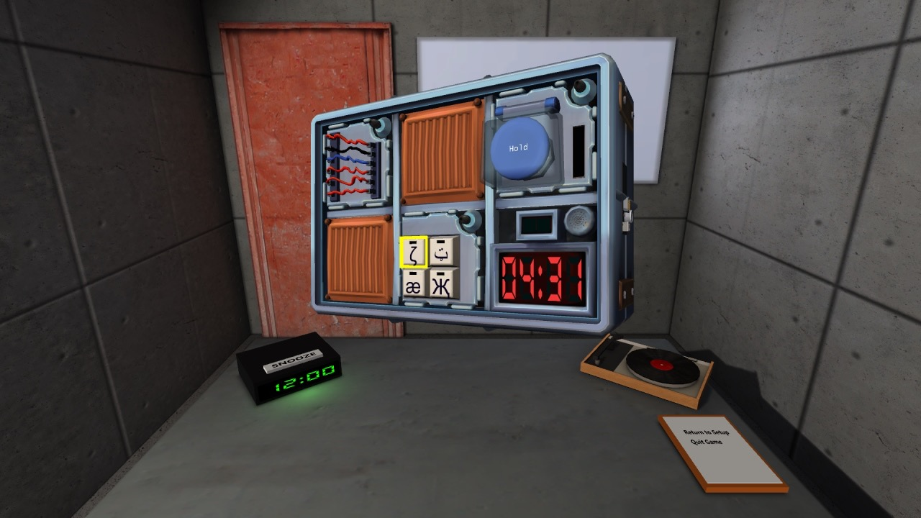
Keep talking and nobody explodes

Slide 120
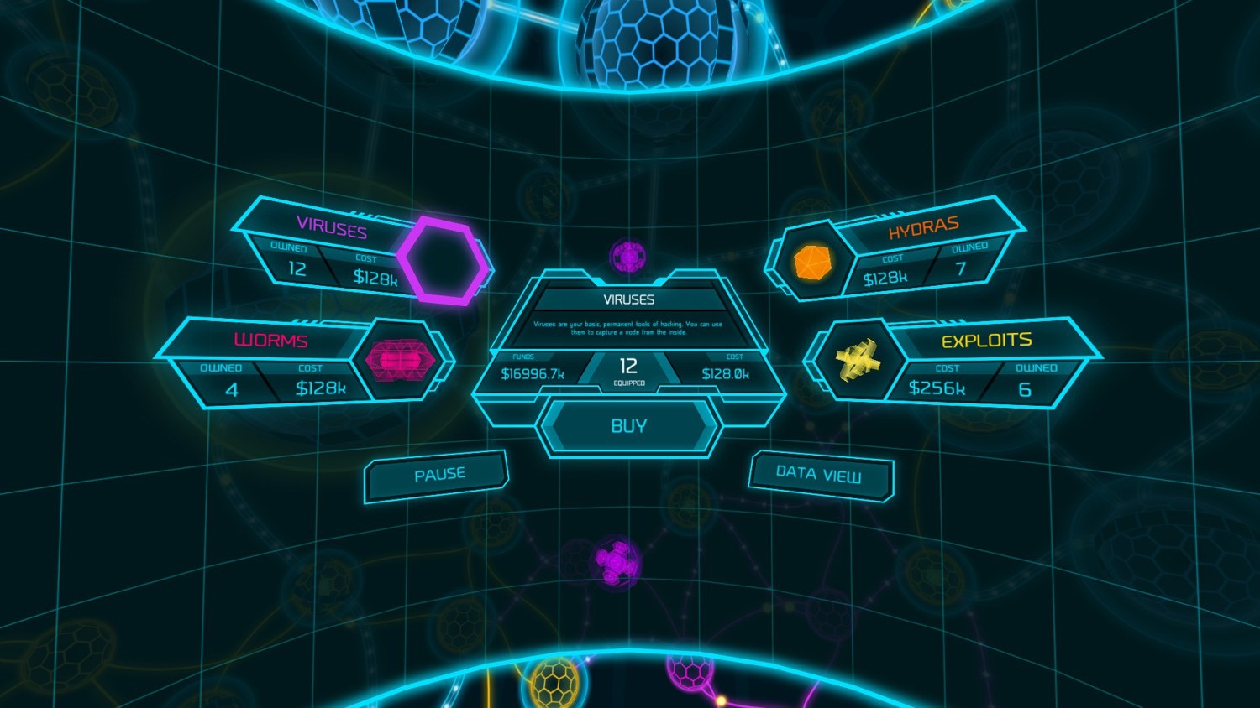
Darknet

Slide 121
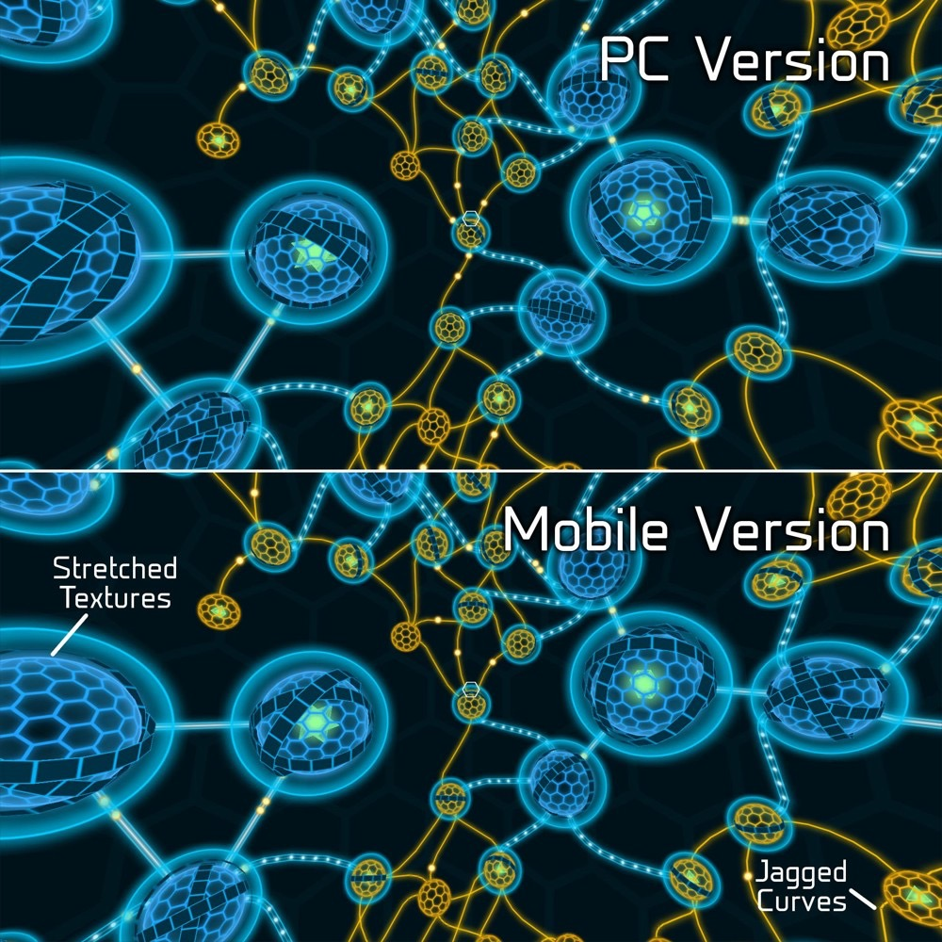

Slide 122
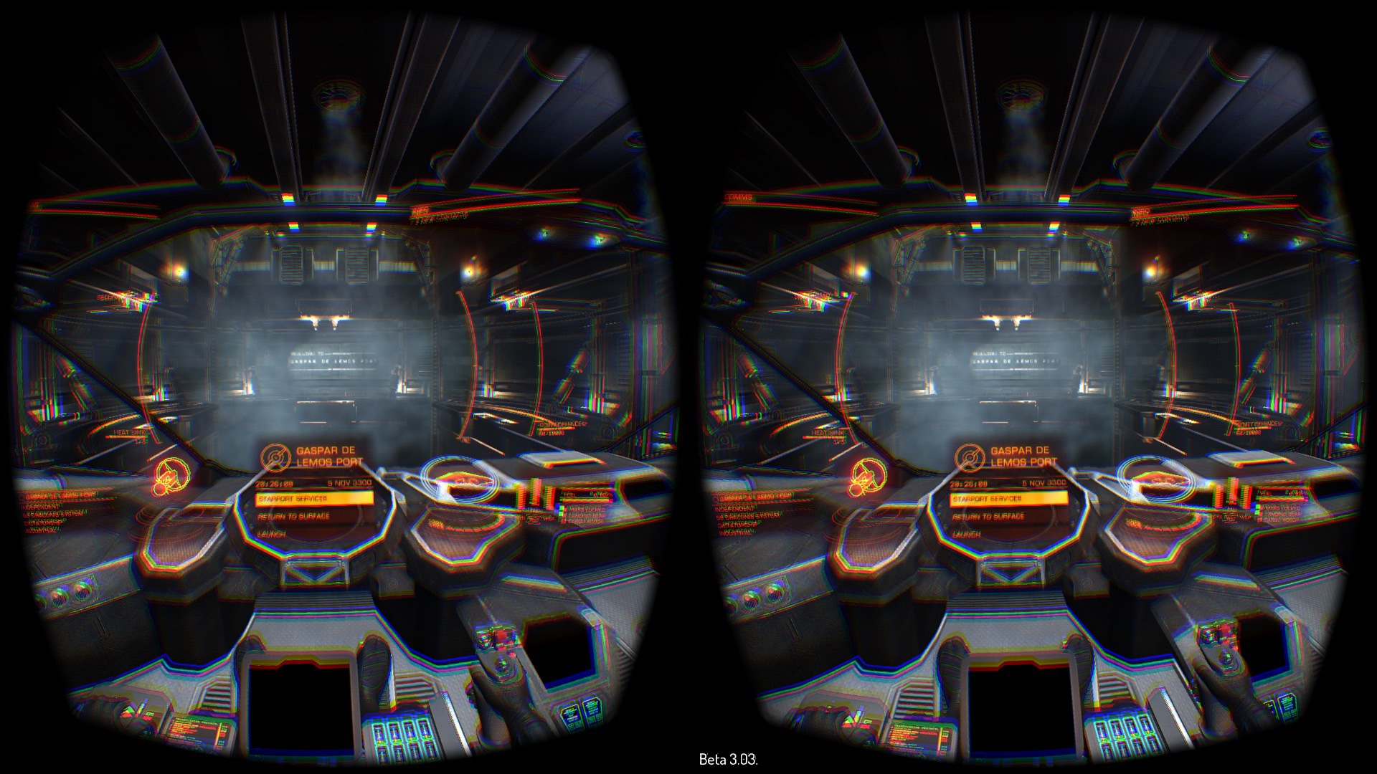
Elite: Dangerous

Slide 123

Thank you!
blog.leapmotion.com
developer.leapmotion.com
developer.oculus.com
docs.unrealengine.com
Andreia Gaita
sh4na
github.com/shana

